Slide 1
Motor Vehicle Thefts Analysis
Overview of the Project
This project is the study of the trends in Motor Vehicle Theft in New Zealand. Given dataset is between the year 2021 and 2022, database contains 6 months of data. Each record represents a single stolen vehicle, with data on vehicle type, make, year, color, date stolen, and region stolen.
Database contains 3 tables
1. Locations
2. Make details
3. Stolen Vehicles

Slide 2
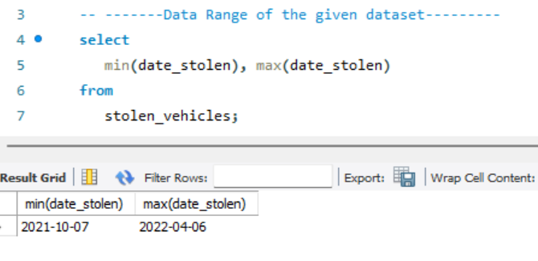
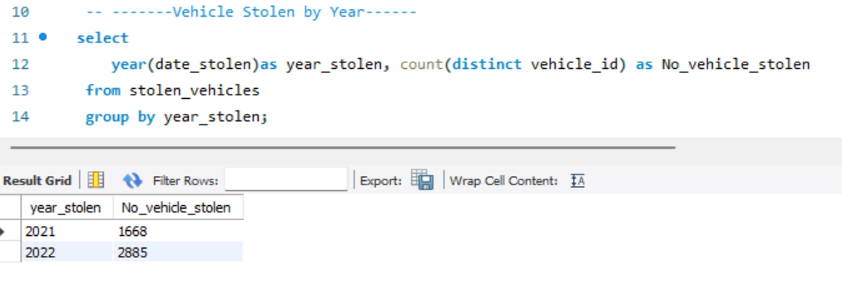
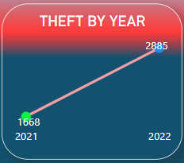
Yearly Vehicle Theft
Trend in vehicle thefts from 2021 to 2022, shows an increase in thefts year over year.

Slide 3
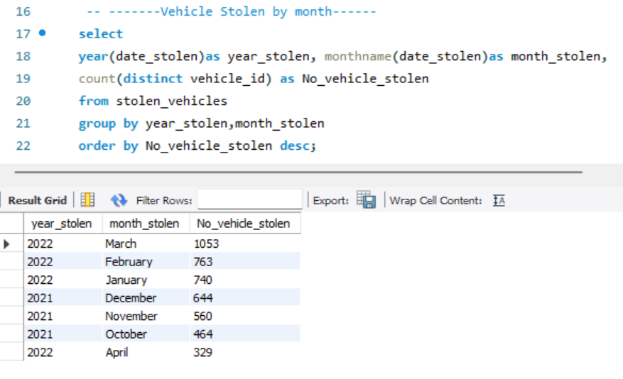
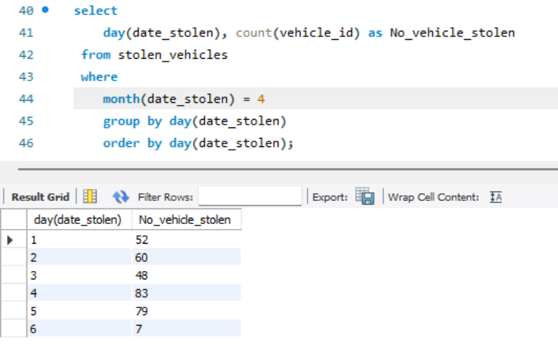
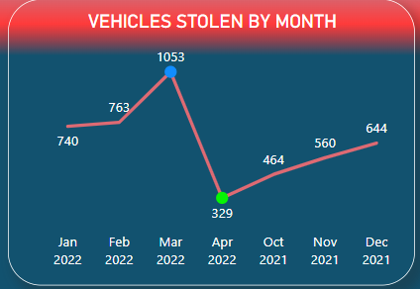
Monthly Vehicle Theft
By month wise we can see the increase in theft, March month is the highest number of theft. April month is the least vehicle stolen, because in data we have only 6 days.

Slide 4
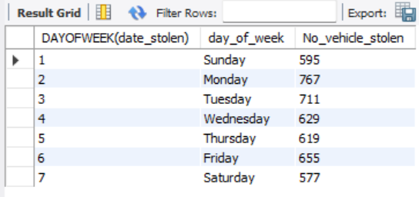
Day of week
Number Values for day of the week
SELECT DAYOFWEEK(date_stolen),
CASE
WHEN DAYOFWEEK(date_stolen) = 1 THEN 'Sunday' WHEN DAYOFWEEK(date_stolen) = 2 THEN 'Monday' WHEN DAYOFWEEK(date_stolen) = 3 THEN 'Tuesday' WHEN DAYOFWEEK(date_stolen) = 4 THEN 'Wednesday' WHEN DAYOFWEEK(date_stolen) = 5 THEN 'Thursday' WHEN DAYOFWEEK(date_stolen) = 6 THEN 'Friday'
WHEN DAYOFWEEK(date_stolen) = 7 THEN 'Saturday'
END AS day_of_week,
COUNT(vehicle_id) AS No_vehicle_stolen
FROM stolen_vehicles
GROUP BY DAYOFWEEK(date_stolen) , day_of_week
ORDER BY DAYOFWEEK(date_stolen) , day_of_week;

Slide 5
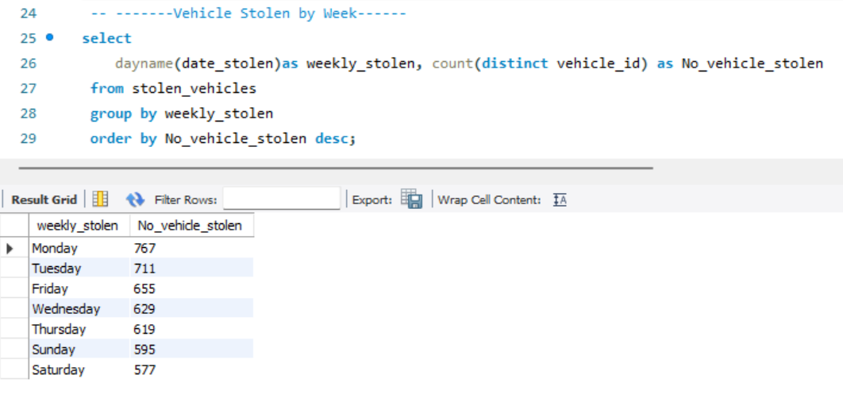
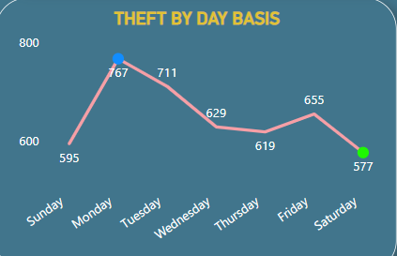
Weekly Vehicle Theft
Monday recorded the highest number of theft (767). Saturday recorded the lowest number of theft (577).

Slide 6
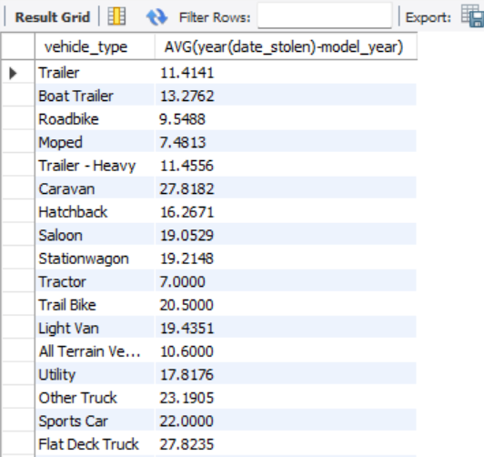
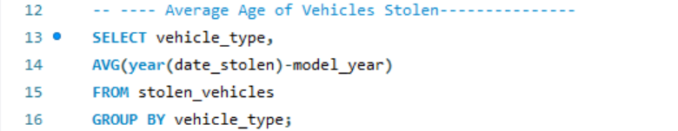
Average Age
To find the average age of the vehicles that are stolen

Slide 7
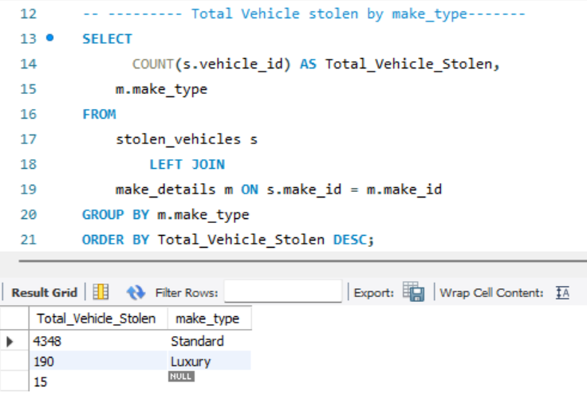
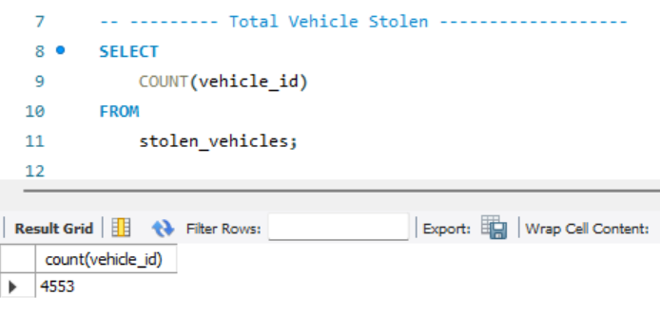
Theft by Vehicle Make Type
Total Vehicle Stolen is 4553.
MAKE TYPE : STANDARD “4348” LUXURY “190” UNKNOWN “15”

Slide 8
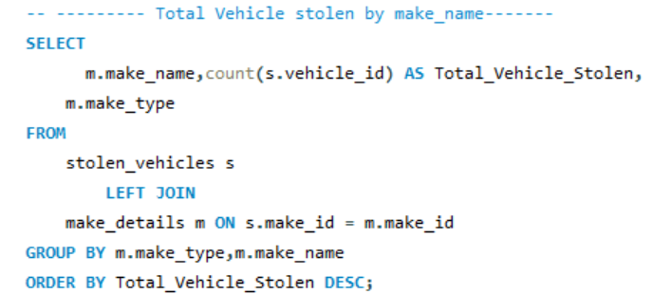
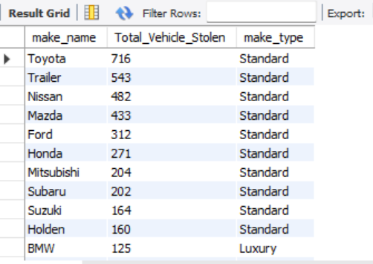
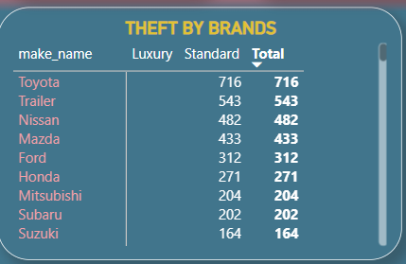
Theft by Vehicle Brand Name
Toyota brand is the highest stolen vehicle

Slide 9
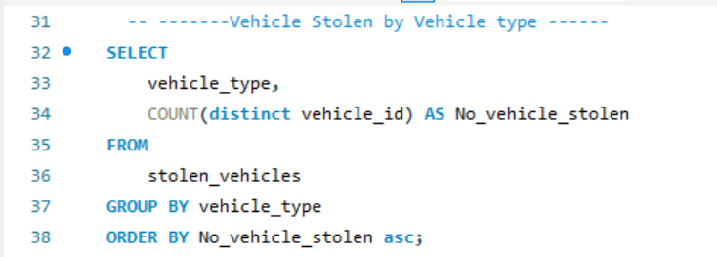
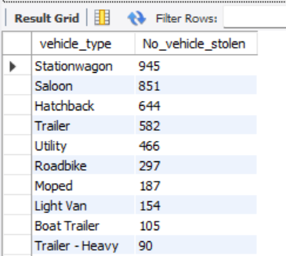
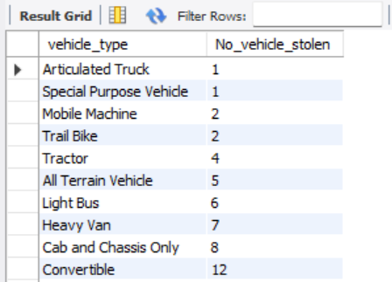
Theft by Vehicle Type
Most stolen vehicle type is Staionwagon and Least stolen vehicle type is Articulated Truck and Special Purpose Vehicle

Slide 10
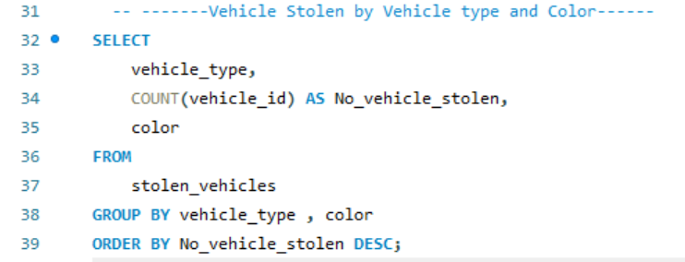
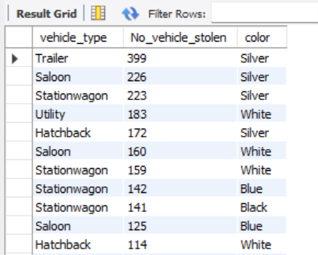
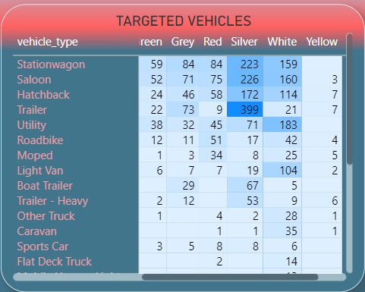
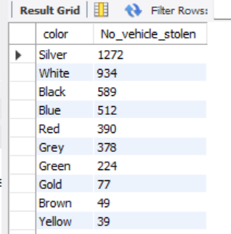
Theft by Vehicle Color
Most stolen vehicle colors are Silver and White.

Slide 11
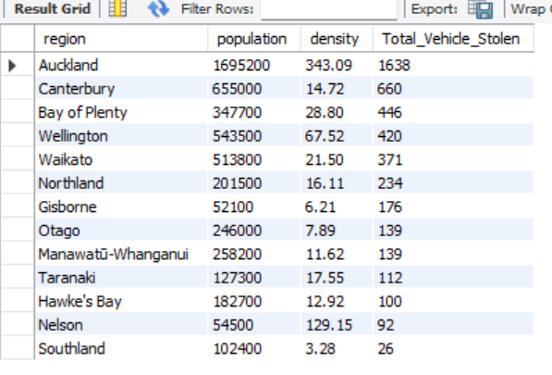
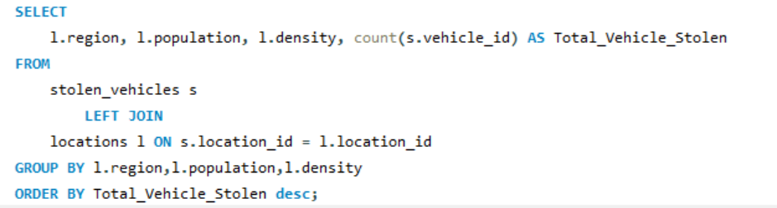
Theft by Population and Density
Auckland is the most densely populated and Southland is the least densely populated in the country.

Slide 12
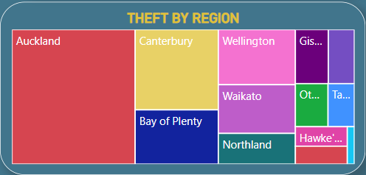
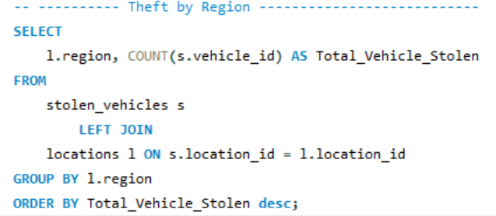
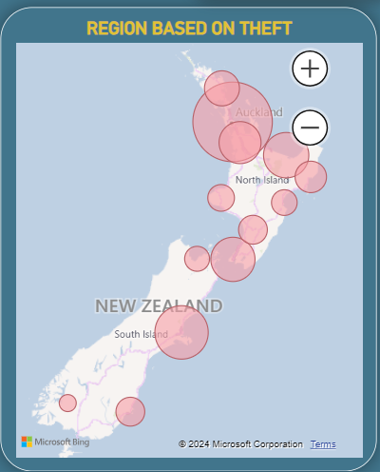
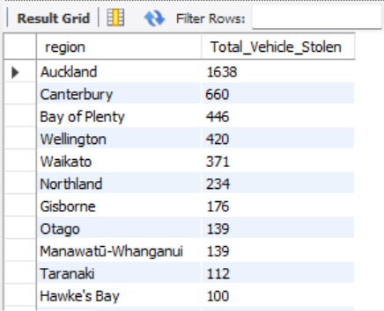
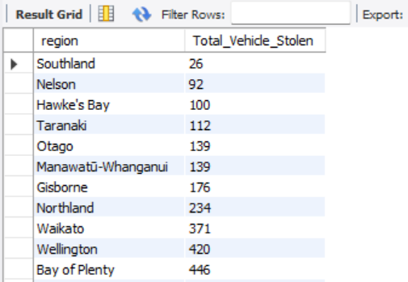
Theft by Region
Top Targeted Region is Auckland (1638). Southland (26) is the least Vehicle Stolen Region.

Slide 13
Conclusion and recommendation
New Zealand police department should create awareness to the public about vehicle theft.
Use new technology and Improve security measures in high-risk regions.
Special attention should be placed on Monday and Tuesday.

